Slide 1

INTRODUCTION TO COMPUTER ORGANIZATION AND ARCHITECTURE
Lecturer: Jay A. Abaleta

Slide 2
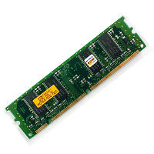

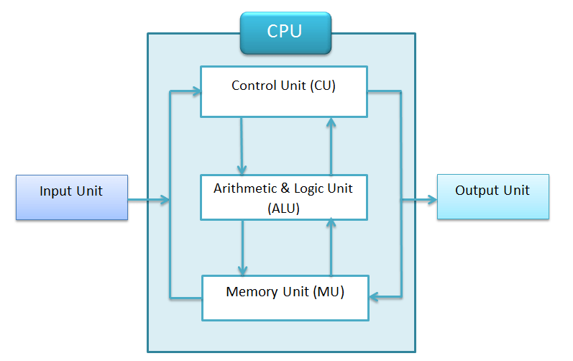
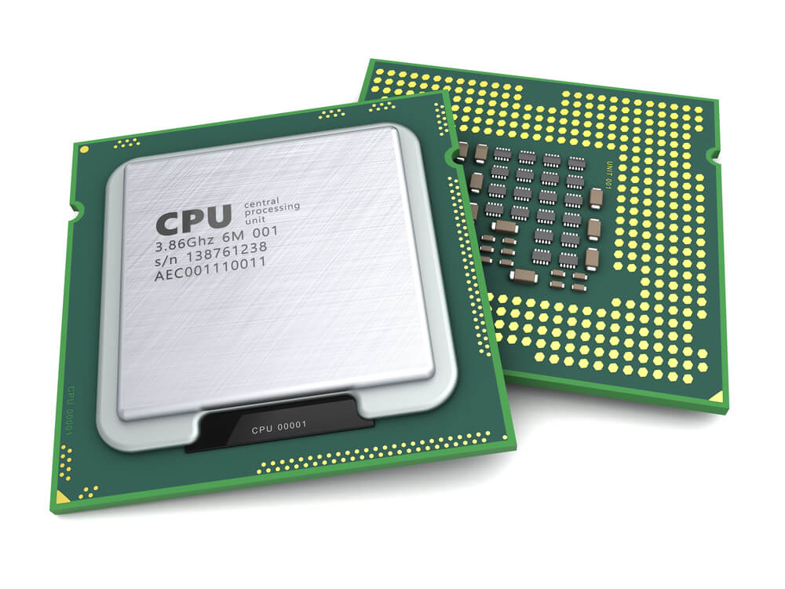
What is Computer Organization?
Computer Organization: Refers to the operational units and their interconnections that realize the architectural specifications. It focuses on hardware components like memory, ALU, and CPU.
Notes:
Examples: Organizational attributes include those hardware details transparent to the programmer, such as control signals; interfaces between the computer and peripherals; and the memory technology used.

Slide 3
What is Computer Architecture?
Computer architecture refers to those attributes of a system visible to a programmer or, put another way, those attributes that have a direct impact on the logical execution of a program.
Examples of architectural attributes include the instruction set, the number of bits used to represent various data types (e.g., numbers, characters), I/O mechanisms, and techniques for addressing memory.

Slide 4
Difference Between Organization and Architecture
Architecture deals with the logical structure (what the computer does).
Organization focuses on the physical structure (how it does it).

Slide 5
The Structure and Function
Structure: Refers to the way components are interconnected to form a complete system.
Examples: CPU, memory, I/O devices, interconnects.
Function: Describes the purpose of each component in processing data.

Slide 6
The Key Functions:
Input: Accept data (e.g., via keyboard, sensors).
Processing: Execute instructions (e.g., using CPU).
Storage: Save data temporarily or permanently (e.g., RAM, HDD).
Output: Deliver results (e.g., screen, printer).
Control: Manage data flow and operations.

Slide 7
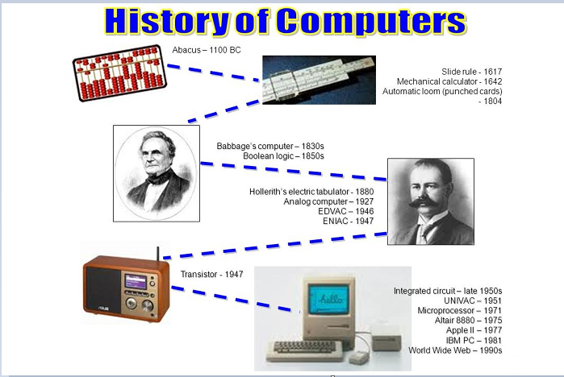
A Brief History of Computers
Computer HistoryBefore 1935, the term “computer” referred to a person who performed numerical calculations using a mechanical calculator. Since then, the definition has changed to mean a machine, rather than a person that accepts input, processes data, stores data and produces output.

Slide 8
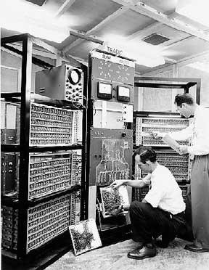
Generations of Computer
The main features are:
Vacuum tube technology
Unreliable
Supported machine language only
Very costly
Generated a lot of heat
Slow input and output devices
Huge size
Need of AC
Non-portable
Consumed a lot of electricity
1st Generation:
1946 – 1959 Vacuum Tube
Notes:
Some computers of this generation were:
ENIAC
EDVAC
UNIVAC
IBM-701
IBM-650

Slide 9
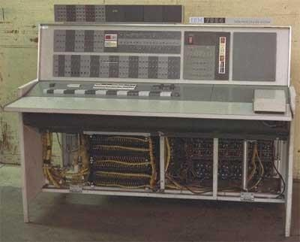
Generations of Computer
The main features are:
Use of transistors
Reliable in comparison to first generation computers
Smaller size as compared to first generation computers
Generated less heat as compared to first generation computers
Consumed less electricity as compared to first generation computers
Faster than first generation computers
Still very costly
AC required
Supported machine and assembly languages
2nd Generation:
1959 – 1965 Transistor
Notes:
Some computers of this generation were:
IBM 1620
IBM 7094
CDC 1604
CDC 3600
UNIVAC 1108

Slide 10
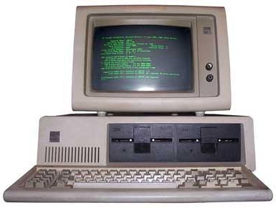
Generations of Computer
The main features are:
IC used
More reliable in comparison to previous two generations
Smaller size
Generated less heat
Faster
Lesser maintenance
Costly
AC required
Consumed lesser electricity
Supported high-level language
3rd Generation:
1965 – 1971 Integrated Circuit
Notes:
Some computers of this generation were:
IBM-360 series
Honeywell-6000 series
PDP (Personal Data Processor)
IBM-370/168
TDC-316

Slide 11
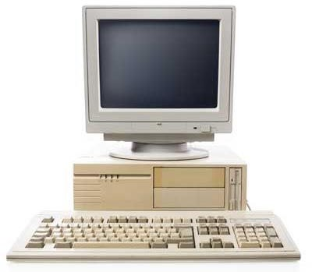
Generations of Computer
The main features are:
VLSI technology used
Very cheap
Portable and reliable
Use of PCs
Very small size
Pipeline processing
No AC required
Concept of internet was introduced
Great developments in the fields of networks
Computers became easily available
4th Generation:
1971 – 1980
VLSI Microprocessor
Notes:
Some computers of this generation were:
DEC 10
STAR 1000
PDP 11
CRAY-1(Super Computer)
CRAY-X-MP(Super Computer)

Slide 12

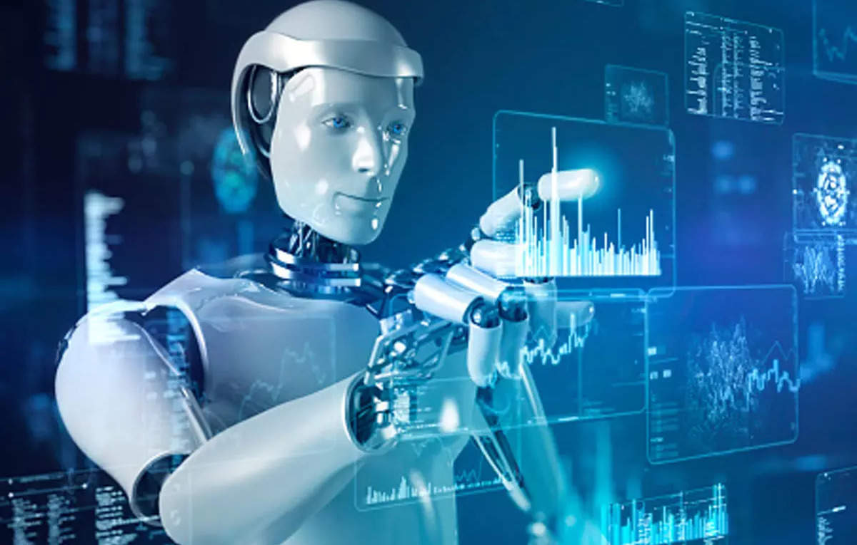
Fifth generation (Present and Beyond)
Fifth generation computing devices, based on artificial intelligence.
AI-driven, quantum computing, IoT integration.
They are still in development, though there are some applications, such as voice recognition, that are being used today.
The goal of fifth-generation computing is to develop devices that respond to natural language input and are capable of learning and self-organization.

Slide 13




What is Von Neumann Architecture?
This is a hypothetical architecture that is derived from the idea of stored-program computers, in which the memory is used for storing both the program data and the instruction data.
Characteristics:
Single memory for data and instructions.
Instructions are executed sequentially.

Slide 14
Components
Control Unit (CU): Manages execution.
Arithmetic Logic Unit (ALU): Performs calculations.
Memory Unit: Stores data and instructions.
Input/Output Devices: Facilitate data transfer.

Slide 15
Advantages and Limitations
Advantages:
Simplifies design with a single memory.
Flexibility in software programming.
Limitations:
Von Neumann Bottleneck: Slower performance due to sequential data transfer between CPU and memory.

Slide 16
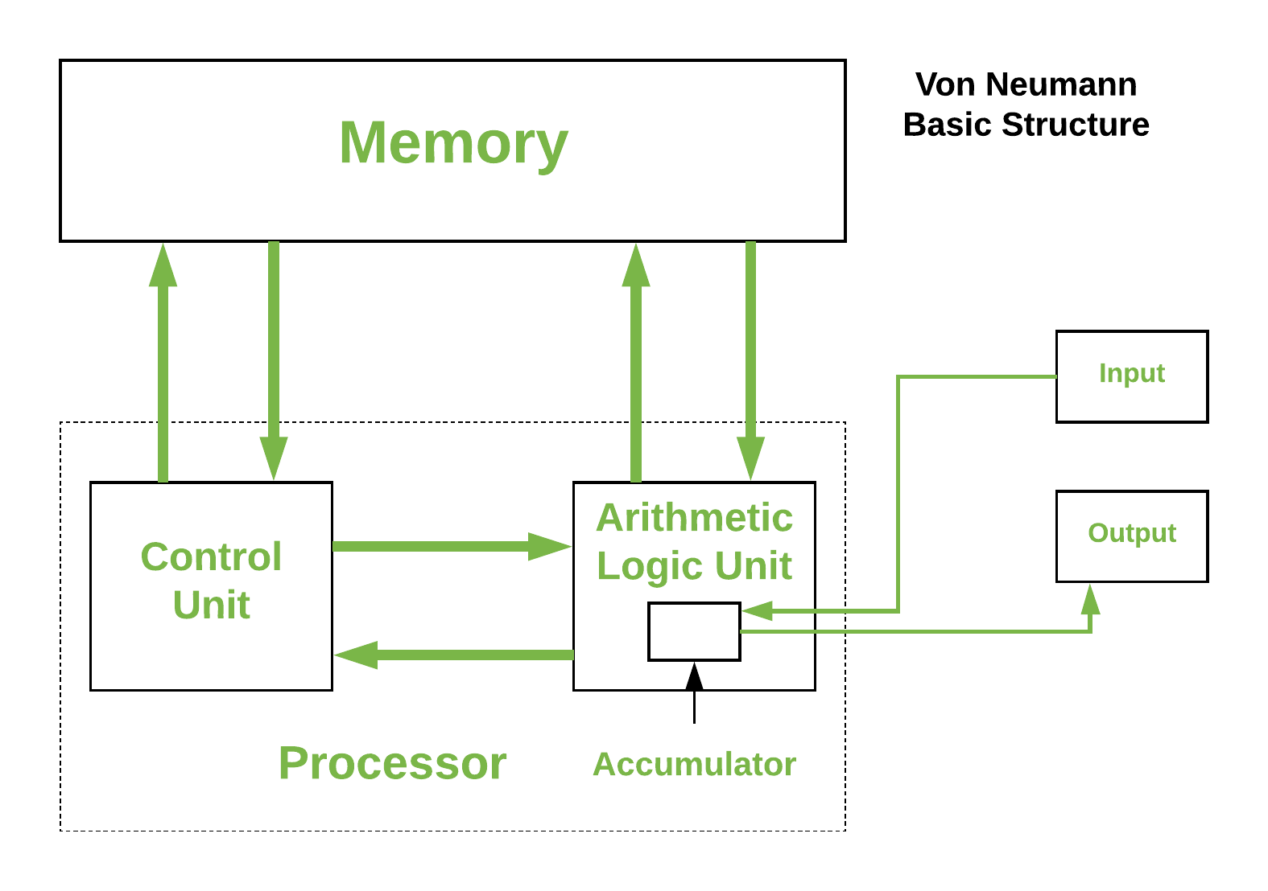
The Von Neumann Basic Structure

Slide 17
The Harvard Architecture
Harvard Architecture is the computer architecture that contains separate storage and separate buses (signal path) for instruction and data. It was basically developed to overcome the bottleneck of Von Neumann’s Architecture.
It is a type of computer architecture that keeps programme data and instructions in storage and signal channels that are physically independent from one another.
Notes:
Real-world computer designs are really based on a modified version of the Harvard architecture, which is frequently utilised in digital signal processors and microcontrollers (Digital Signal Processing).

Slide 18
Characteristics and Components
Characteristics:
Separate memory for data and instructions.
Parallel access to both memories, allowing faster execution.
Components:
Instruction Memory: Stores program instructions.
Data Memory: Stores data processed by the program.

Slide 19
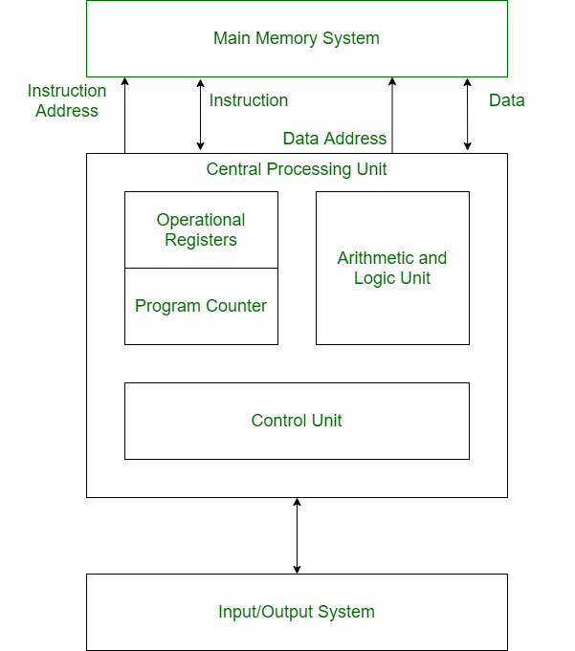
Structure of Harvard Architecture
Notes:
The main advantage of having separate buses for instruction and data is that the CPU can access instructions and read/write data at the same time.

Slide 20
Comparison of Von Neumann and Harvard Architectures
Feature | Von Neumann Architecture | Harvard Architecture
Memory Type | Single memory for data & instructions | Separate memories for data & instructions
Performance | Slower due to sequential access (bottleneck) | Faster due to parallel access
Complexity | Simpler design | More complex design
Usage | General-purpose systems | Embedded systems, DSPs

